Slide 1
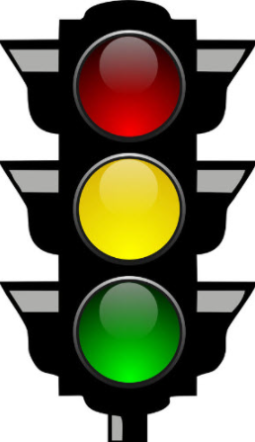
COJ Traffic Calming Program District 10 October 25th, 2021 by Christopher W. LeDew, P.E. Chief of Traffic Engineering

Slide 2
Types of Traffic Calming
Speed Humps and Speed Tables
Raised Crosswalks
Bulb-outs and narrowing lanes
Mini-Roundabouts
Lowering the Posted Speed Limit

Slide 3
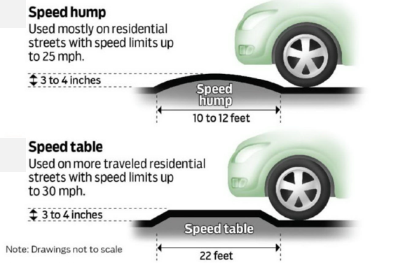
Speed Humps and Speed Tables

Slide 4
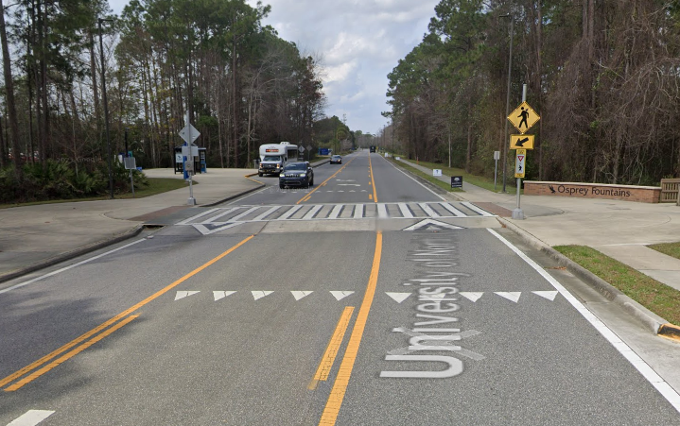
Raised Crosswalks
Notes:
Raised crosswalk at UNF

Slide 5
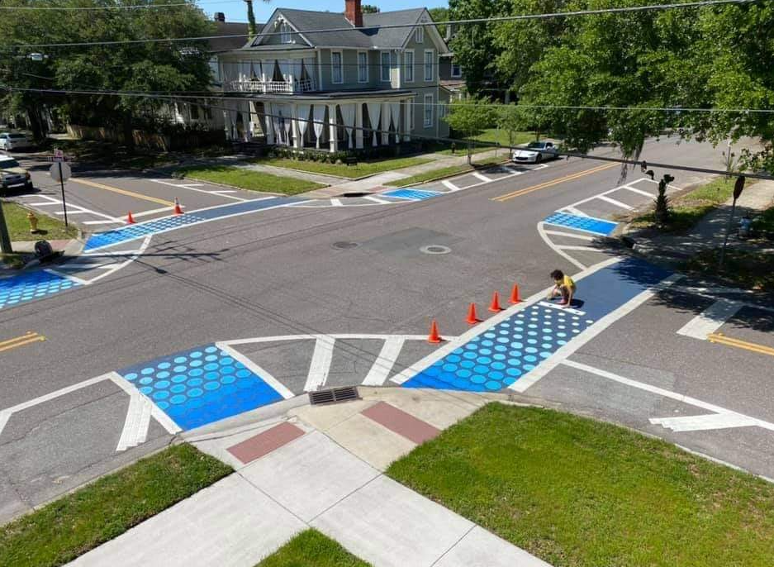
Bulb-Outs & Narrowing Lanes
Notes:
Bulb-out at 3rd Street and Hubbard Street

Slide 6
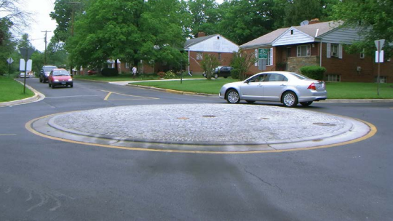
Mini-Roundabouts
Notes:
Mini-roundabout in Tacoma Park Maryland

Slide 7
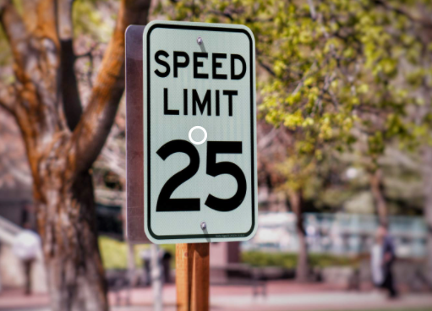
Lowering the Posted Speed Limit
Pros:
Residents may feel safer
JSO can enforce at lower threshold
Cons
Signs may not change behavior
Installation costs

Slide 8
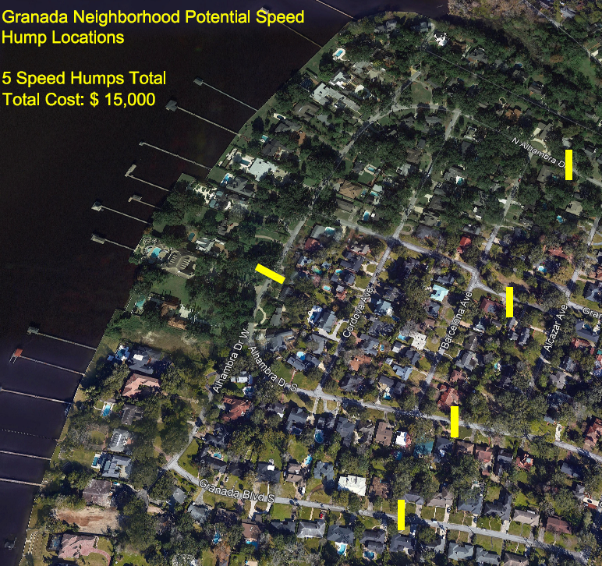
COJ Traffic Calming Process
Safety Study
Data driven
100% COJ funded
2. Petition
No crash trend
75% agreement
Homeowners pay
3. CIP/CRA Funds
Gate Parkway
Harts Road
St. Johns Avenue
Notes:
Shows an upcoming speed humps by petition project for the Granada neighborhood.
The neighborhood will pay 100% of the cost.

Slide 9
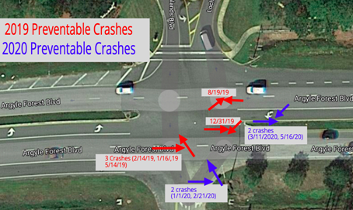
COJ Traffic Calming Process
Reported Crashes
Field Reviews
Speed Studies
Customer Complaints
Statistical comparison
Prioritized by crash rate
Notes:
Crash diagram at Argyle Forest and Loch Highlands

Slide 10
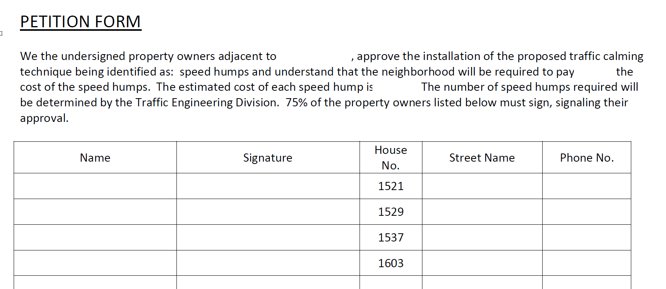
Petition Process
COJ Ordinance 2014-666-E
Sec. 804.406. Speed limit on local roads by petition

Slide 11
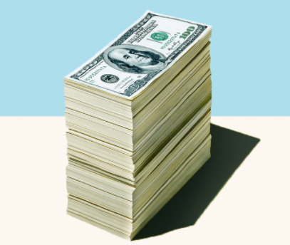
Funding
Traffic Engineering is funded for $150,000 of traffic calming projects each year
Funds are for safety projects and petition projects
Traffic engineering pays 100% of safety projects
Example:
1 speed hump costs: $ 3,600
Neighborhood pays: $3,000
If “cut-through” -> neighborhood pays: $ 1,500

Slide 12
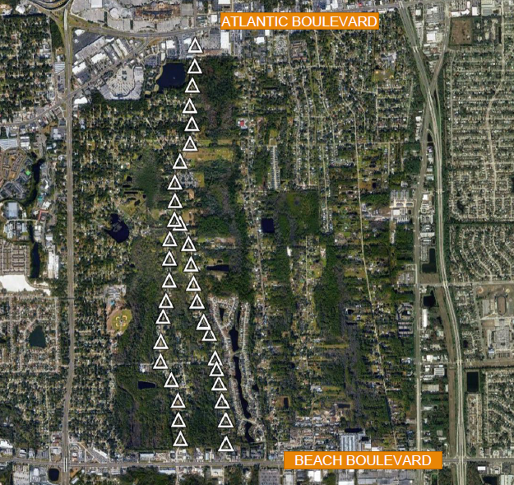
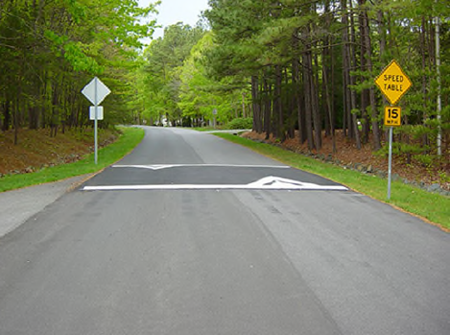
Southside Estates Safety Project
High Crash rate found on Peach Dr., Forest Blvd., & Live Oak Dr.
Project with speed 35 tables
COJ Paid 100%
Total Cost: $ 224,000

Slide 13
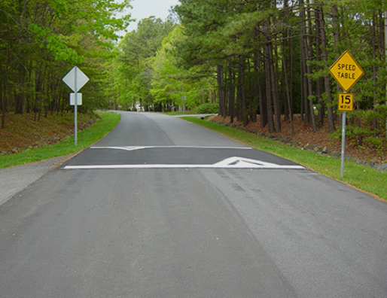
Results of Southside Estates
Installed 35 speed tables.
85th Percentile Speed Before:
40 mph
85th Percentile Speed After:
31 mph

Slide 14
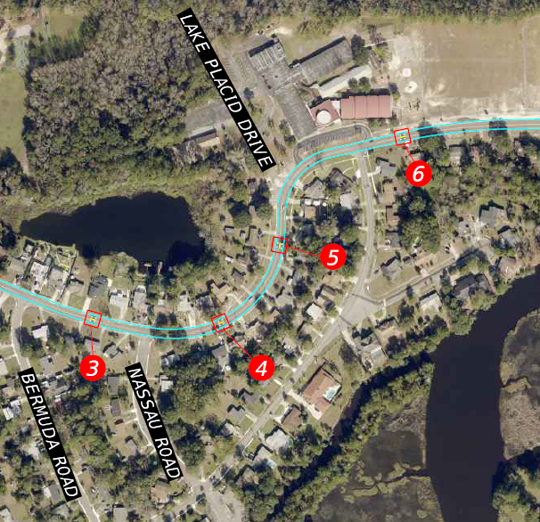
Upcoming Safety Projects
Harborview Area- Clyde Drive between Addison & Ribault
12 Speed Tables
$ 76,800 (City pays)

Slide 15
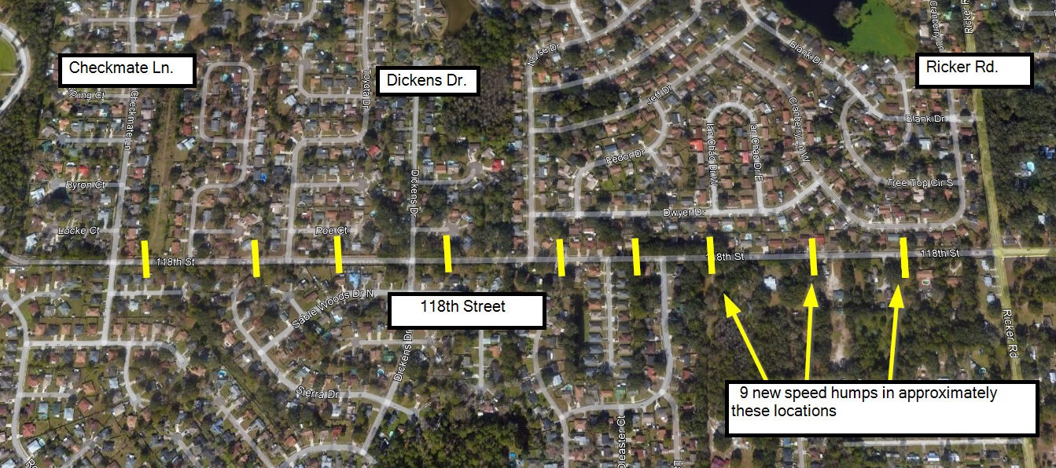
Upcoming Petition Projects
Jacksonville Heights Area- 118th Street between Checkmate Ln. & Ricker
9 Speed Tables
$ 13,500 (cut-through price, neighborhood pays & 75% must sign)
Notes:
Speed tables cost $ 6,400 each.
The picture shows 1/12 speed humps on Clyde Drive.

Slide 16
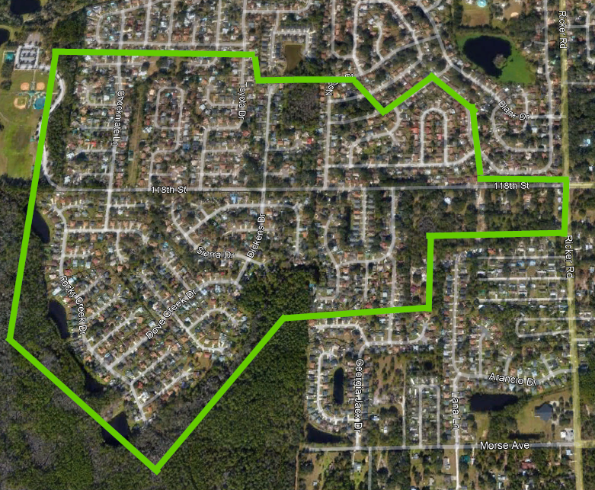
Who is eligible to sign?
Notes:
The green area includes the property owners who are eligible to sign.
The homeowners inside of the green area are expected to use 118th as their primary way into and out of the area.

Slide 17
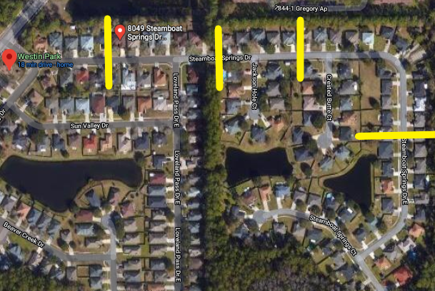
Upcoming Petition Projects
Westin Park Area- Steamboat Springs Dr.
4 Speed Humps
$ 12,000 (neighborhood pays and 75% must sign)

Slide 18
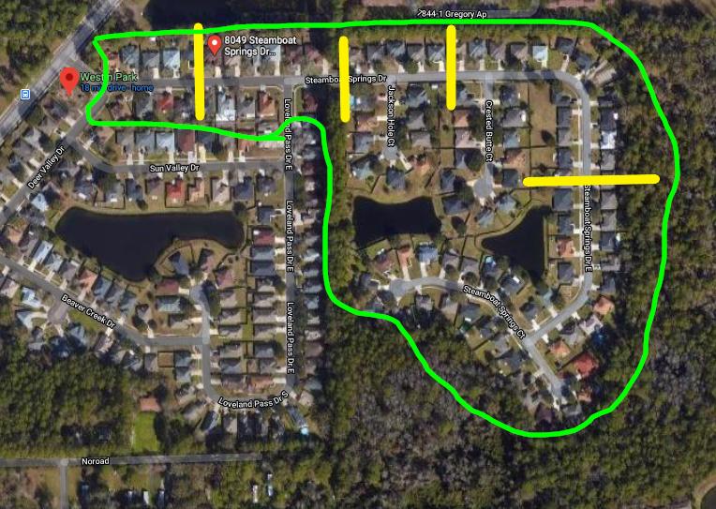
Who is eligible to sign?
Notes:
The green area includes the property owners who are eligible to sign.
The homeowners inside of the green area are expected to use 118th as their primary way into and out of the area.

Slide 19
Questions?

